Slide 1


Google Ads - Basics & How it Works

Slide 2
Basics Of PPC
What is PPC
Pay-per-click (PPC) is an advertising model that lets advertisers place ads on an advertisement platform where there is a cost for every click on the published ad.
PPC is used for all types of campaign goals, including:
Generating leads
Getting Calls
Promoting brand awareness
PPC is all about relevance. Users are searching for specific products, services, and information at any given time.

Slide 3
Initial Analysis
Benefits of PPC
PPC Contributes To Business Goals
PPC Has Various Targeting Options
Increase brand Awareness
Compete even if your search engine rankings aren't high
Lead Generation
Tracks Your Users Every Step Of The Way

Slide 4
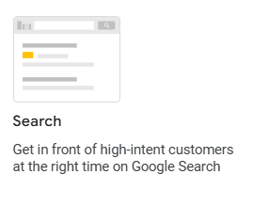

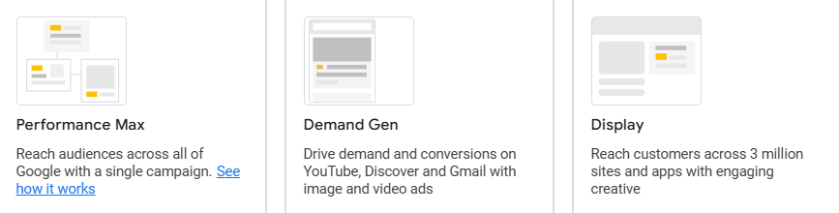
Types Of Google Ads Campaigns

Slide 5
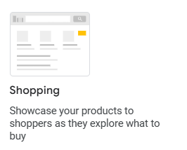
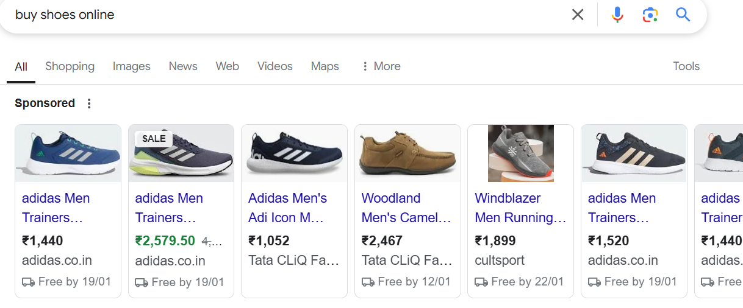
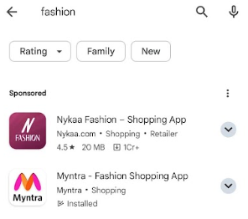
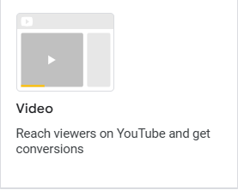
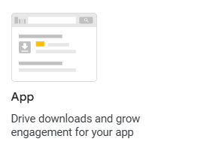

Types Of Google Ads Campaigns

Slide 6
Important Points While Performing PPC Campaign
1. Keyword Research - To Select Relevant Keywords for a product/service
Keyword Match types
Broad match
The default match type, which allows your ad to appear when a user's search query includes any word in your keyword phrase, in any order. This type of match can reach a wide audience, but it can also result in irrelevant clicks.
Example - Share market classes in pune, then our ad will show on classes in pune search as well.
Phrase match
A more flexible match type than exact match, but still requires a close match between the keyword and the search query. The keyword must appear in the search query in the same order as it is written, but other words can appear before or after it. Example - “Share Market classes in pune”, Our ad will show on searches starting from Share market

Slide 7
Important Points While Performing PPC Campaign
Exact match
A match type that only shows your ad when a user searches for the exact phrase or word that you've bid on. Exact match keywords are surrounded by brackets in your Ad Group. Example - [Share market classes in pune], our ad will show particularly when this term will be searched
2. Headings & Descriptions
Write Compelling headings & Description containing keywords, check what competitors are using
3. Audience Targeting
Select Relevant Audience to whom we want to show ads
4. Location Targeting
Select Locations on which you want to run the ads

Slide 8
How to set up Google Ad for Campaign?
These are some simple steps to set up Google Ad account:
Sign Up with your Google account
Select Campaign
Set Your budget
Select Location
Select Your Target Audience
Choose Your Keywords
Add Ad Groups ( If there are multiple Products / Services)
Write Ad
Create your ad

Slide 9
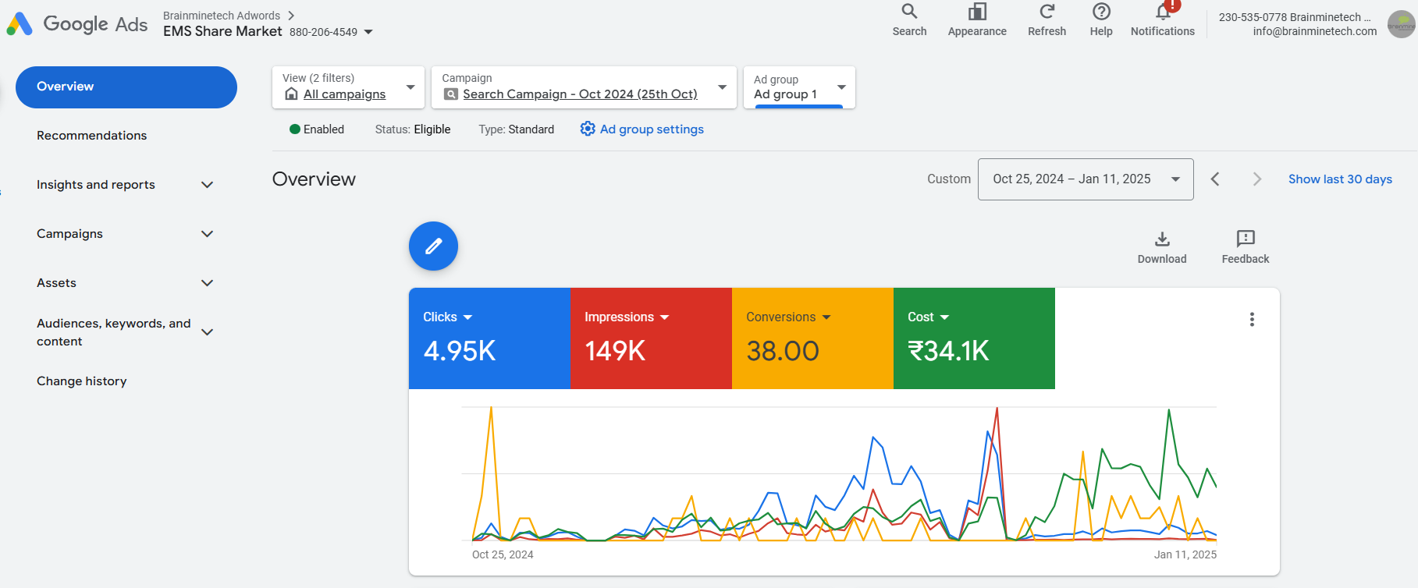
Overview Of Google Ads - EMS Share market Classes

Slide 10
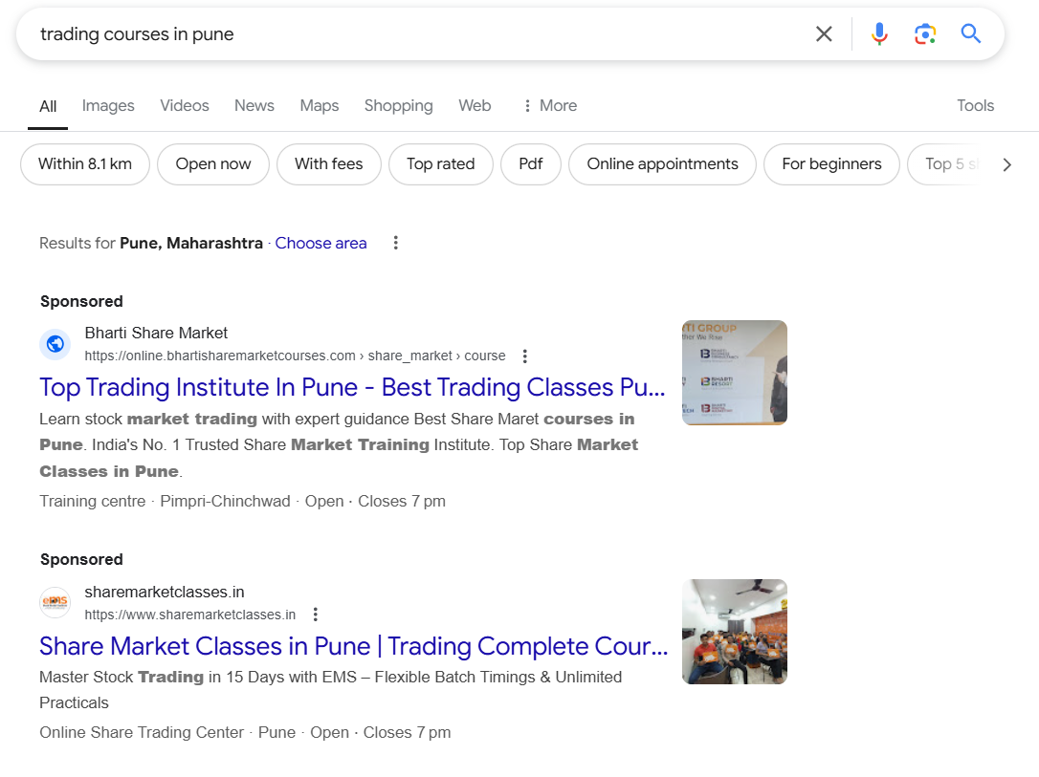
Search Campaign

Slide 11
PPC Plan Preparation

Slide 12
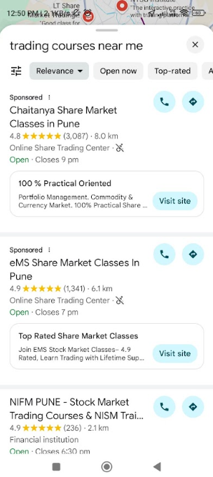
GMB Smart Campaign

Slide 13
How to setup GMB Smart Campaign

Slide 14
THANK
YOU

